Slide 1
Elementary Graph Algorithms
SUBMITTED BY :- ABHINAV SINGH
ROLL NO. :- 1811210001
CSE 2ND YEAR(GROUP-1)

Slide 2
GRAPH :-
GRAPH
Graph is a data structure that consists of a set of nodes (vertices) and a set of edges.
The set of edges describes relationships among the vertices .
A graph G is defined as follows: G = (V, E)
where
V(G): a finite, nonempty set of vertices
E(G): a set of edges (pairs of vertices)

Slide 3
REPRESENTATION OF GRAPH :-
GRAPH – REPRESENTATION OF GRAPH
We have two standard ways to represent a graph G = (V,E) as a collection of adjacency lists or as an adjacency matrix.
Either way applies to both directed and undirected graphs.
We use adjacency matrix representation for dense graphs and adjacency list representation for sparse graph.

Slide 4
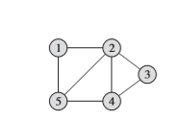
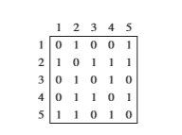
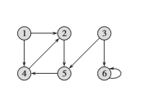
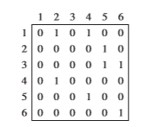
1. Adjacency matrix representation
GRAPH – REPRESENTATION OF GRAPH
EXAMPLE - 1 :-
EXAMPLE – 2 :-

Slide 5
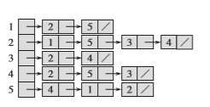
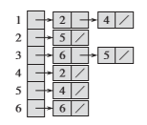
2. Adjacency lists representation
GRAPH – REPRESENTATION OF GRAPH
EXAMPLE - 1 :-
EXAMPLE – 2 :-

Slide 6
1. Directed graph :-
GRAPH – Directed and Undirected Graphs
It will contain directed edges (has an orientation (has an arrow head)) .
and all edges are directed.
2. Undirected graph :-
It will contain undirected edges (has no orientation (has no arrow head)) .
and all edges are undirected.

Slide 7
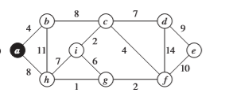
Weighted graph :-
GRAPH – weighted graph
A graph in which each edge carries a value known as its weight
Example :-

